Slide 1
Tag Rugby Coach Education 22nd November 2012

Slide 2
Agenda
6pm – Welcome & Register
Info about Rugby Rookies and CRP
Coaching Process & APES
Group Tasks
Format for tonight; Drills & Skills - Video Clips
Rules of the game
Q & A
Practical on Astro 7pm – 8pm
Equipment info
W/up – BR & LS
Coaching Tasks
Tag Rugby the Game

Slide 3
Tag Rugby in Orkney
Tag Rugby is currently being delivered across Mini sections at Kirkwall/St. Andrews and Dounby as well as the CRP.
1045 children across the mainland and Isles schools (P1-7) received tag rugby coaching last academic year.
Great sport for mixed sexes encouraging team work-organisation-health and exercise-ball handling & hand eye coordination – physical competencies-discipline-positive communication and always working in conjunction with C of E.

Slide 4
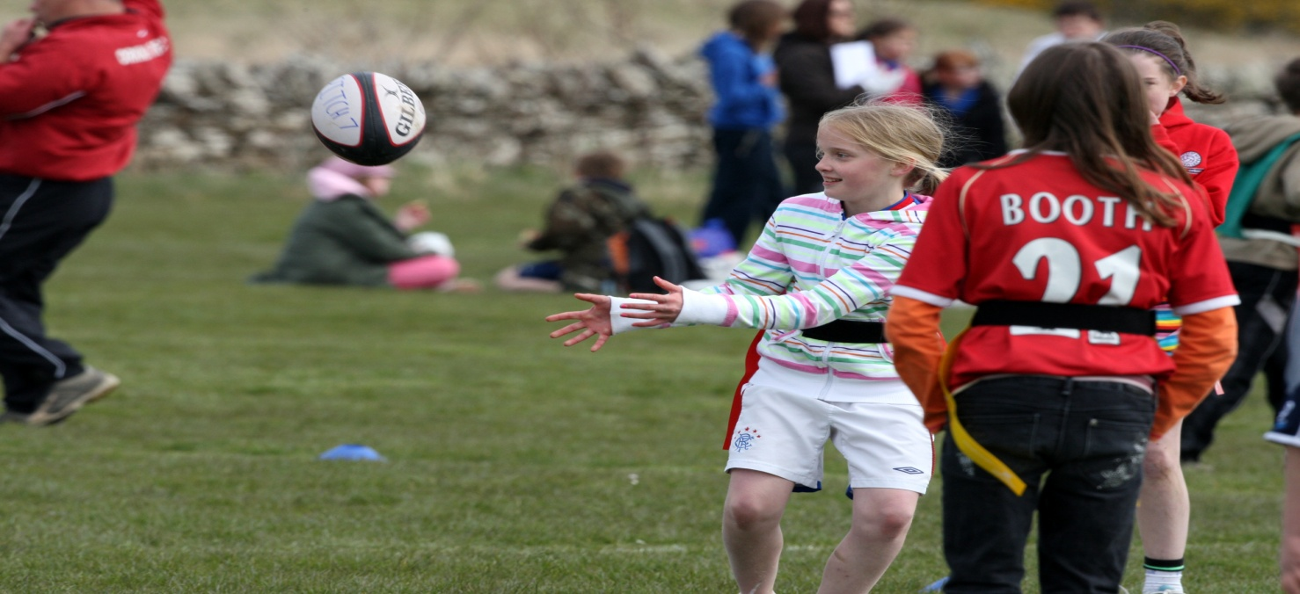
APES – principle.
Activity – Max participation
Purpose – What are your aims of the exercise/drill or game?
Enjoyment – Do the kids look happy and having a good time?
Safe – No danger to participants.

Slide 5
HOWS of Coaching – Coaching Process
Explanation &Instruction.
Demonstration.
Imitation &Observation and Analysis.
Correction-Feedback
A simple way to remember this is in the form of EDIC.
Explanation - of the skill/exercise.
Demonstrate - the exercise effectively using a high skill player/s or coach.
Imitation - by the participants of the skill/exercise, (Conducting the exercise).
Correction – give feedback on how they can better their actions. Positive Corrective feedback e.g. that’s was great, but if you also follow through with your hands you will have a more accurate pass etc

Slide 6
Providing Instruction & Explanation
1: Plan what to say before you speak
2: Gain their attention before you start
3: Keep the message
simple
4: Invite questions and check for
understanding

Slide 7
Providing Demonstrations
1: Position so all can see and hear
2: Focus attention on 1-2 key points
3: Repeat appropriate demo more than once
4: Invite questions and check for
understanding

Slide 8
Key factors in Observation and Analysis
1: Focus on each key factor one at a time
2: Observe action several times from different positions
3: Compare observation with correct template to find matches and mismatches
4: Determine action: build on strengths, correct errors, do nothing

Slide 9
Providing Feedback
1: Ask questions to generate
self-feedback
2: Limit information to
1-2 key points
3: Give specific simple information
4: Keep it
positive

Slide 10
Group Tasks
Warm/ups – BR & LS
Group1
Stuck in the mud.
Group 2
Stadium Ball
Group 3
Hand/Catch - Mini shuttles
Group 4
Evasive Running – Tag Bull Dogs
GROUP 5 – Ball Skills
Game Coaching
All groups!!
“In your delivery use the Coaching Process & APES principles”
Split into groups!
EDIC
APES

Slide 11
Drill & Skills
You will now see a variety of exercises and drills, please feel free to take notes. These will be part of your group tasks for the practical part of the course.
Please ask questions if you are unsure of anything.
Tutor-Assign groups to their exercise!!
Groups will conduct a 6 minute plan for their allocated task and deliver to the rest of the group.

Slide 12
Rules of the Game
Tag Rugby Rules
After being tagged, the ball carrier has 3 seconds to pass the ball, in this time they can also take 3 steps, if they are within 2 steps of the try line, they can score.
Players making the tag must shout ‘TAG’ and then hold the tag above their head.
Offside line is the ball after a TAG; any defending players obstructing the pass are offside. Penalty as a result.
Tap & pass acts as restart for all purposes. Defending team must be back 5 metres.
There should be no contact in Tag Rugby at all. A Penalty will occur against offending players.
A try will be disallowed if the player dives or drops onto two knees/or dives in the act of a score. If a player has slipped or been pushed the referee has final decision.
Defending players who dive for the TAG will be penalised as will players who come off their feet trying to recover a loose ball.
Any hand-offs, protecting tags, shirt pulling, over zealous spinning or unnecessary contact will be penalised.
Players must give the Tag back after a successful tag.
Two hands must be on the ball at all times, unless they have broken away and clear of any defenders. Penalty against offenders.
No forward passing – Sideways & Backwards passing only!

Slide 13
Questions?????
Q`s
We will send the resources to you from tonight's exercises via e-mail.

